Slide 1
REAL-TIME CODE EDITOR
CODE FUSION
ANJALI VERMA
2111981265

Slide 2

INTRODUCTION
Code fusion is a real-time code editor with a multi-user feature.
It allows multiple users to collaborate on coding tasks simultaneously, similar to how Google Docs enables real-time document collaboration.
The motivation behind this project was to create a collaborative coding environment where users can write, edit, and run code together in real-time.
This is especially useful for remote coding interviews, pair programming, and educational purposes where real-time feedback and collaboration are essential.

Slide 3





REACT
WEB SOCKET
CHAKRA UI
NODE JS
EXPRESS JS
TECH STACK

Slide 4
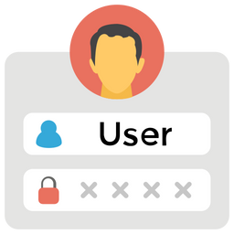
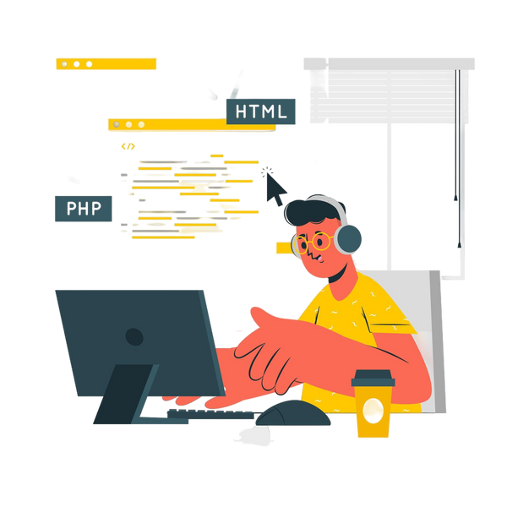
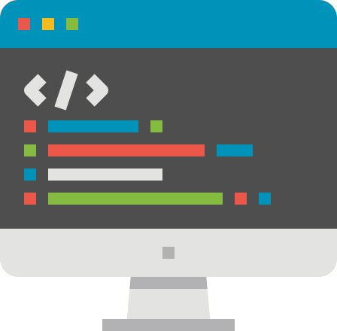

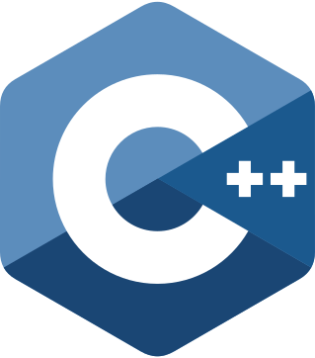
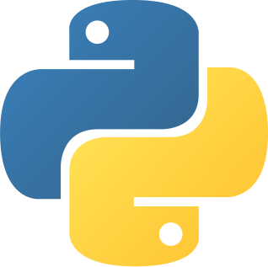
ARCHITECTURE OVERVIEW
Create Room
Write code
Leave Room
1
3
5
2
4
Choose Language
Run Code

Slide 5
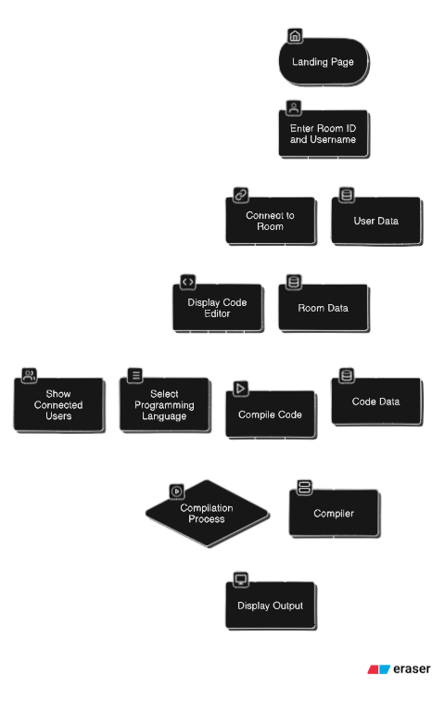
HIGH
LEVEL DESIGN

Slide 6
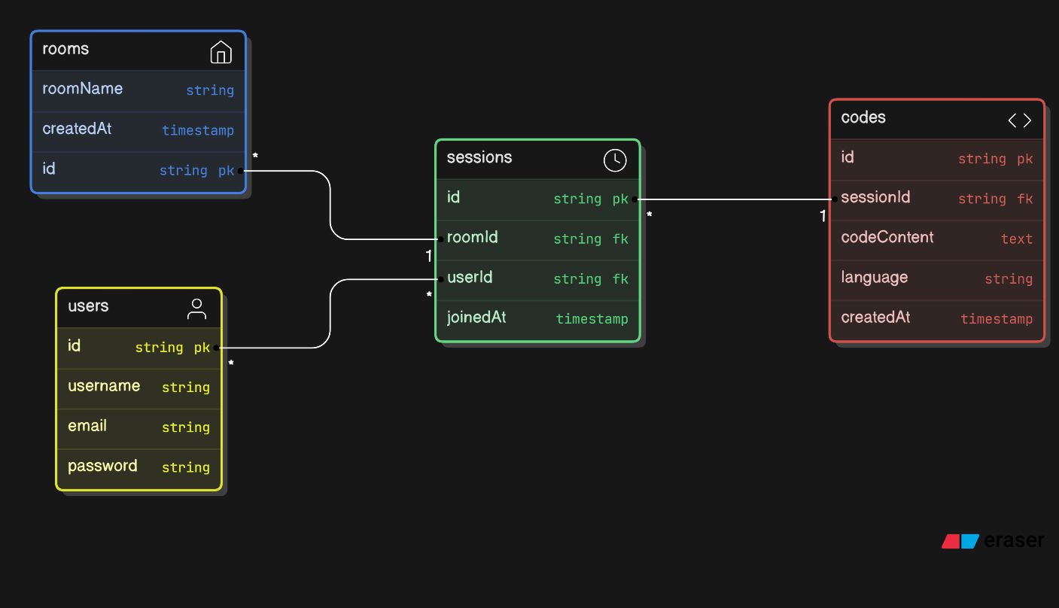
ER DIAGRAM

Slide 7
1
Real-Time Collaboration
2
Multi-Language Support
FEATURES
3
Real-Time Error Detection
4
Predefined Templates
5
Copy Room ID & Leave Room Feature

Slide 8

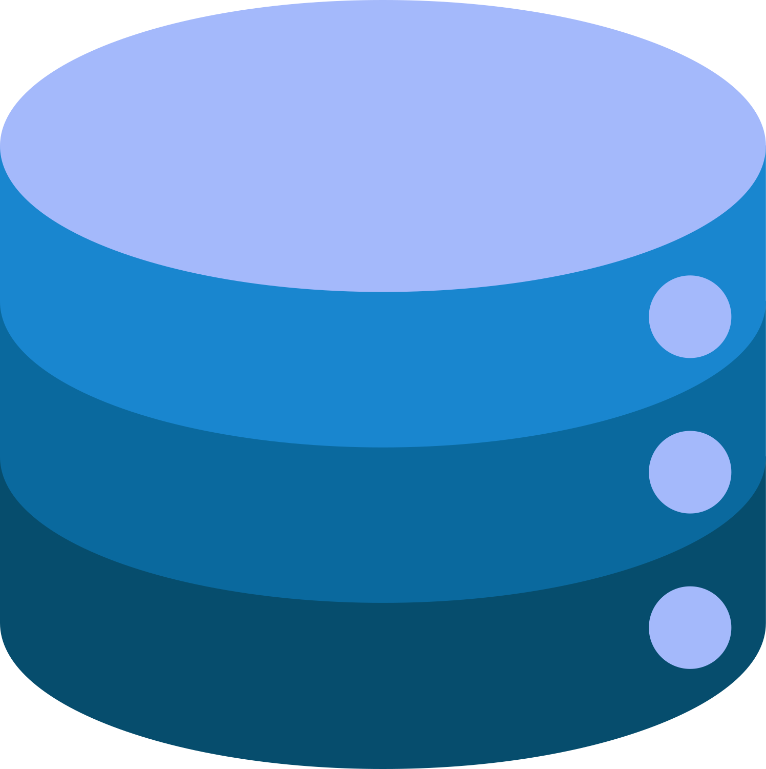

LIMITATIONS
DATA PRIVACY
SCALABILITY
INTEGRATION
Real-time collaboration involves transmitting code over the internet, which can pose security risks if not properly encrypted and secured.
Handling multiple simultaneous users and large volumes of data can strain server resources and impact performance.
Integration with other tools and services (e.g., code editor and compiler API’s) can be complex and may not always be seamless.

Slide 9



FUTURE ENHANCEMENTS
GOOGLE AUTHENTICATION
VERSION CONTROL INTEGRATION
COLLABORATIVE FEATURES
Integrate video chat ,chat or comment features to facilitate communication between collaborators while coding.
Implement Google Sign-In functionality to provide users with a seamless and secure authentication option.
Integrate with version control systems (like Git) to track changes, commit code, and manage versions.

Slide 10
THANK YOU
THANK YOU

